Slide 1

KARNATAK UNIVERSITY
II Sem M.Sc. Physics
PHCT 2.3: Nuclear and Particle Physics (General)
Dr. Rajashekhar F. Bhajantri
Department of Physics
Karnatak University, Dharwad

Slide 2
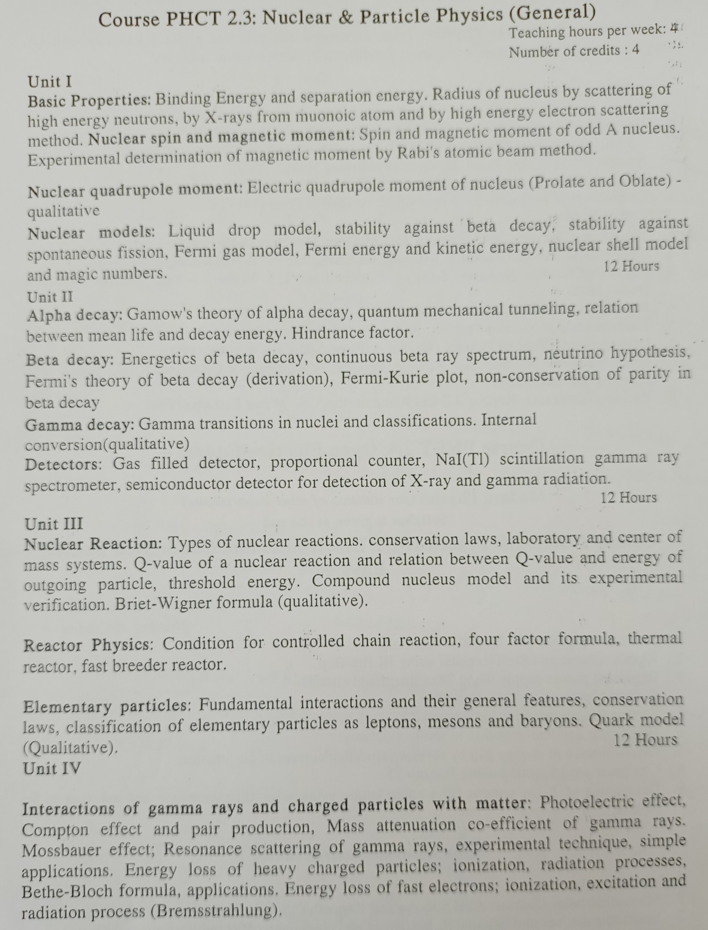

Slide 3
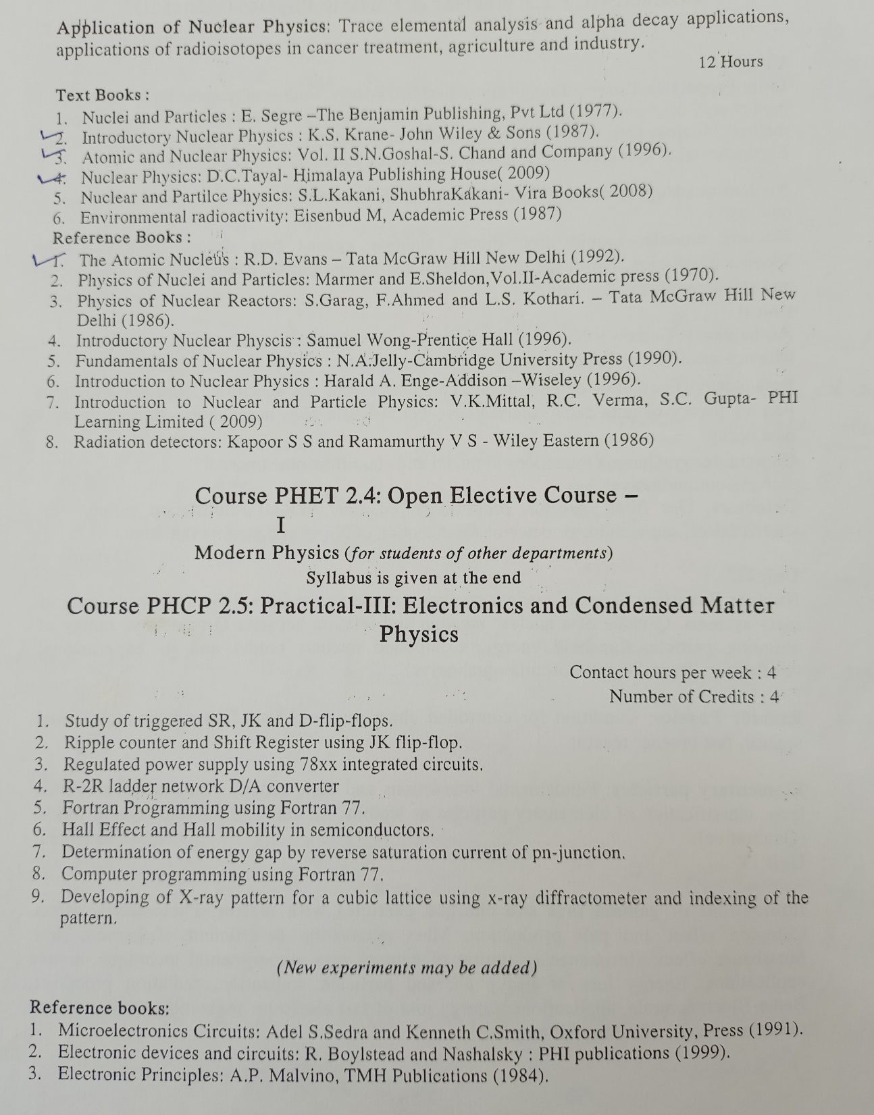

Slide 4
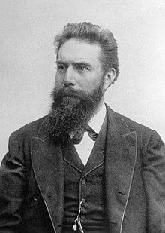
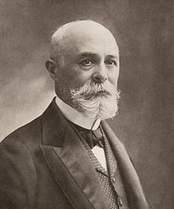
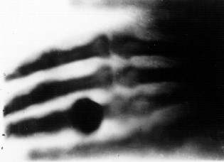
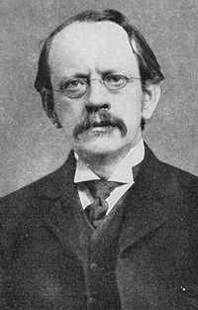
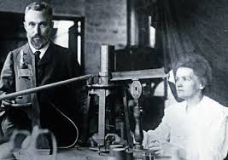
Historical Milestones of Nuclear Physics
The history of nuclear physics as a discipline distinct from atomic physics starts with the discovery of X-rays by Wilhelm Roentgen in 1895, discovery of radioactivity by Henri Becquerel in 1896.
First X-ray image of Roentgen’s wife's hand
Henri Becquerel
Wilhelm Roentgen
In 1897, J. J. Thomson showed that cathode rays were composed of previously unknown negatively charged particles (now called electrons) - "plum pudding" model
Pierre and Marie Curie studied radioactivity, which led to their discovery of Radium and Polonium in 1898. Frederic Joliot and Irene Joliot-Curie discovered the artificial radioactivity in 1934 awarded Nobel Prize in Chemistry in 1935
J. J. Thomson

Slide 5
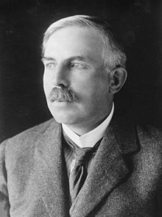
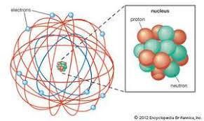
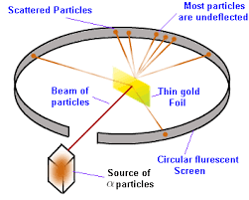
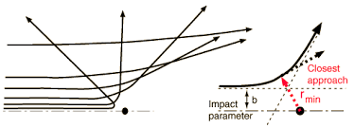
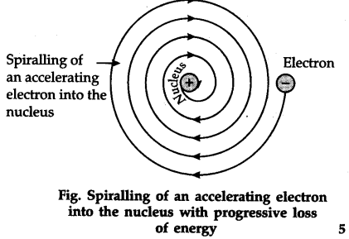
Historical Milestones of Nuclear Physics
In 1911 Ernest Rutherford proposed the Nuclear Model of an Atom, based on 1909 Geiger–Marsden gold foil experiment.
The atomic nucleus is small, dense region, positively charged, consisting of protons and neutrons at the center
Electrons are orbiting spirally
inward around the nucleus
in order to balance out the charge.
Ernest Rutherford

Slide 6
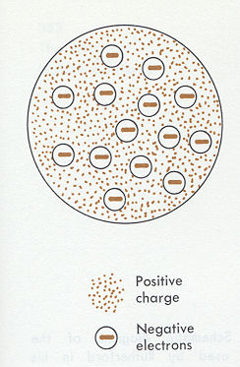
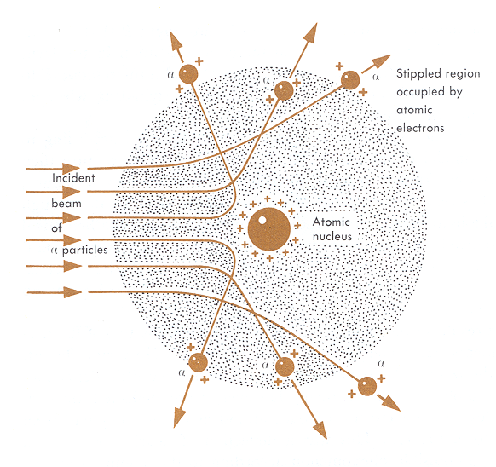
Thomson’s Model
Rutherford’s Model

Slide 7
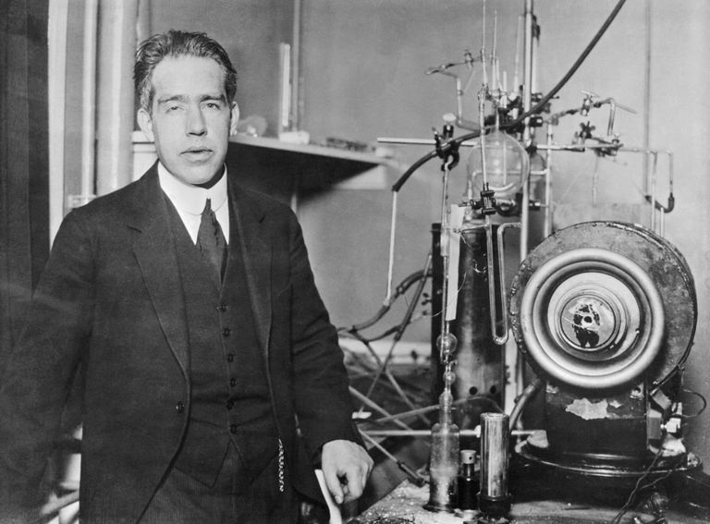
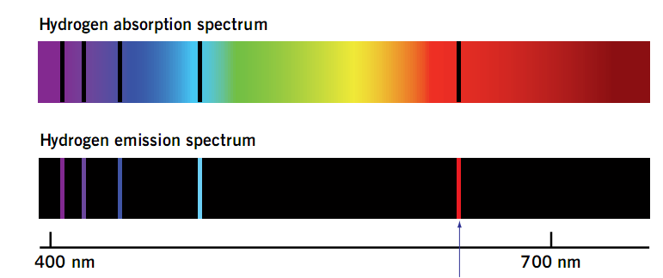
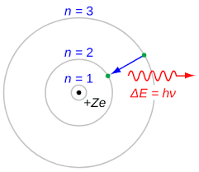
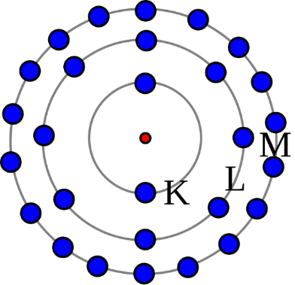
Niels Bohr Atomic Model
In 1913 Niels Bohr proposed the Bohr Model to understand the atomic structure and quantum theory, for which he received Nobel Prize in Physics in 1922.
The electron is able to revolve in certain stable orbits around the nucleus without radiating any energy - called stationary orbits and are attained at certain discrete distances from the nucleus.
Electrons can only gain and lose energy by jumping from one allowed orbit to another, absorbing or emitting electromagnetic radiation with a frequency ν determined by the energy difference of the levels
Niels Bohr

Slide 8
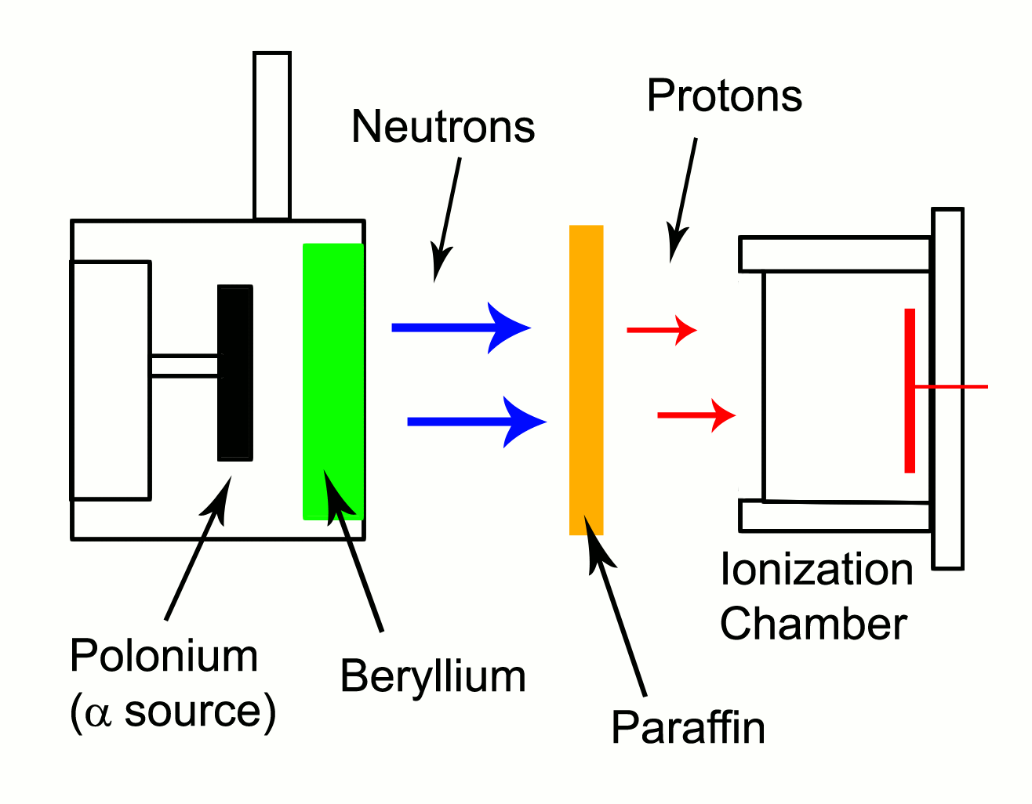
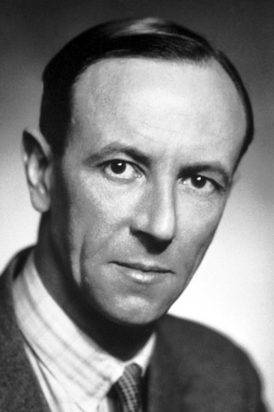
Discovery of Neutron
James Chadwick
Rutherford's theory of Neutrons was proved in 1932 by his associate James Chadwick, who recognized neutrons immediately when they were produced by other scientists and later himself, in bombarding beryllium with alpha particles. In 1935, Chadwick was awarded the Nobel Prize in Physics for this discovery.

Slide 9
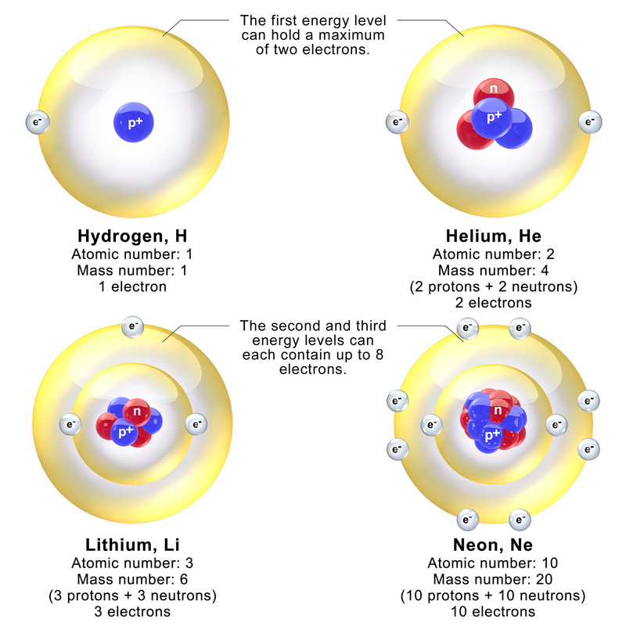
Niels Bohr Atomic Model

Slide 10
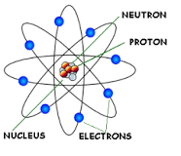
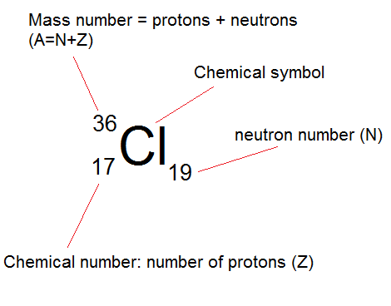
Atomic Nucleus
Nucleus the central part of an atom contains almost entire mass of the atom consists of two principal elementary particles, namely, proton and neutron.
Proton is a positively charged
particle, while neutron has zero
electrical charge.
The negative counterpart of
proton, i.e. electrons revolves round
the nucleus in some specific
quantized orbits.
X = element symbol
Z (atomic number) =
number of protons in nucleus
N = number of neutrons in nucleus
A (atomic mass number) = Z + N

Slide 11
Reasons why electrons cannot exist within the nucleus:
Nuclear size
The Heisenberg’s uncertainty principle puts a lower limit on its kinetic energy that is much larger that any kinetic energy observed for an electron emitted from nuclei (its actually the result of β-decay). The radius of the atomic nuclei is 10⁻¹⁵ m and if electrons were exist in the nucleus the maximum uncertainty in its position would have been 10⁻¹⁵ m. Mass of the electron is 9.1 x 10⁻³¹ kg. No electron or particle in the atom posses energy greater than 4MeV.
∆x = 10⁻¹⁵ m
Now, according to Heisenberg uncertainty principle,
Δx × Δp = h/4π, ∴ Δx × mΔv = h/4π and ∆v = h/4πmΔx
Mass of electron, m = 9.1 × 10⁻³¹ kg ,
∆x = 1 × 10⁻³⁵ m
∴ ∆v = 6.6 × 10⁻³⁴ kg m² s⁻¹ / 4 × 3.14 × 9.1 × 10⁻³¹ kg × 1 × 10⁻¹⁵ m
= 5.77 x 10¹⁰ ms⁻¹
The value of uncertainty in velocity, ∆v is much higher than the velocity of light (3.0 × 10⁸ ms⁻¹ ) and hence an electron cannot be found within atomic nucleus.

Slide 12
Reasons why electrons cannot exist within the nucleus:
Nuclear spin
If a deuteron nucleus were to consist of protons and electrons, the deuteron must contain 2 protons and 1 electron. A nucleus composed of 3 fermions must result in a half-integral spin. But it has been measured to be 1. So no electrons can possible in the nucleus
Nuclear magnetic moment:
The magnetic moment of an electron is over 1000 times larger than that of a proton. The measured nuclear magnetic moments are on the same order of magnitude as the proton’s, so an electron cannot be a part of the nucleus.
The de-Broglie wavelength:
The de-Broglie wavelength of electron decay is several times greater than the size of nucleus. As a result an electron cannot be confined inside the nucleus.

Slide 13
Assume the radius of the nucleus is approximately 10⁻¹⁴ m. If electron is to exist inside the nucleus, then uncertainty in the position of the electron is given by ∆x= 10⁻¹⁴ m.
According to uncertainty principle,
∆x∆p_{x} = h/2π. Thus ∆p_{x}=h/2π∆x Or ∆p_{x} = 6.62 x10⁻³⁴/2 x 3.14 x 10⁻¹⁴
∆p_{x}=1.05 x 10⁻²⁰ kg m/ sec
If this is p the uncertainty in the momentum of electron, then the momentum of electron should be at least of this order, that is p = 1.05 x 10⁻²⁰ kg m/sec.
An electron having this much high momentum must have a velocity comparable to the velocity of light. Thus, its energy should be calculated by the following relativistic formula
E = √ m²₀ c⁴ + p²c²
E = √(9.1 x 10⁻³¹)² (3 x 10⁸)⁴ + (1.05 x 10⁻²⁰)² (3 x 10⁸)²
= √(6707.61 x 10⁻³⁰) + (9.92 x 10⁻²⁴)
= (0.006707 x 10⁻²⁴) +(9.92 x 10⁻²⁴)
= √9.9267 x 10⁻²⁴
E = 3.15 x 10⁻¹² J
Or E = 3.15 x 10⁻¹²/1.6 x 10⁻¹⁹ eV
E = 19.6 x 10⁶ eV Or E= 19.6 MeV
Therefore, if the electron exists in the nucleus, it should have an energy of the order of 19.6 MeV. However, it is observed that beta-particles (electrons) ejected from the nucleus during b – decay have energies of approximately 3 Me V, which is quite different from the calculated value of 19.6 MeV. Second reason that electron can not exist inside the nucleus is that experimental results show that no electron or particle in the atom possess energy greater than 4 MeV. Therefore, it is confirmed that electrons do not exist inside the nucleus.

Slide 14
Nuclear Properties
Each nuclear species with a given Z and A is called a nuclide
Both neutrons and protons, collectively called nucleons, are constructed of other particles called quarks
Nuclides with the same neutron number are called isotones and the same A are called isobars
Atoms with the same Z, but different mass number A, are called isotopes.
Hydrogen’s isotopes:
  Deuterium: Heavy hydrogen. Has a neutron as well as a proton in its nucleus.
  Tritium: Has two neutrons and one proton, is radioactive, about 40 tons on earth.

Slide 15
Nuclear Charge and Mass
Particle | Charge | Mass (kg) | Mass (u) | Mass (MeV/c²)
Proton | +e | 1.6726 x 10⁻²⁷ | 1.007276 | 938.28
Neutron | 0 | 1.6750 x 10⁻²⁷ | 1.008665 | 939.57
Electron | −e | 9.109 x 10⁻³¹ | 5.486x10⁻⁴ | 0.511
Unified mass unit, u, defined using Carbon 12
Mass of 1 atom of ¹²C ≡ 12 u
Recall Einstein Einstein’s equivalency formula for m and E:
E=mc²; c = 3 x 10⁸ m/s.
The energy of a mass of 1 u can be found:
E = (1u) c² = (1.660559 x 10⁻²⁷ kg)(3 x 10⁸ m/s)²
E = 1.49 x 10⁻¹⁰ J or E = 931.494 MeV

Slide 16
Nuclear Forces
There are four fundamental forces: gravitational, electromagnetic (coulombic), strong interaction (strong nuclear), and weak interaction (weak nuclear).
Gravitational force: This is principally involved in interactions between large objects. It is too weak at the atomic level to be of much consequence in its effects and is, therefore, not as important at the nuclear level as other forces.
Electromagnetic (coulombic) force: This force, acting mainly outside the nucleus, is exerted on electrically charged particles. An attractive force, it is responsible for holding electrons and protons together in atoms. To understand the comparative strengths of the electromagnetic and gravitational forces, consider the following. The distance between an electron and a proton is roughly 5x10⁻⁹ cm. The electromagnetic force between the two is approximately 9.2x10⁻³ dynes, whereas the gravitational force is only around 4x10⁻⁴² dynes. It is obvious that gravitational force is negligible at the atomic level.

Slide 17
Strong interaction (strong nuclear) force: This binds the nucleons together. Although it is much stronger than the electromagnetic force, it does not act outside the nucleus. The strong interaction force is approximately 100 times stronger than the electromagnetic force, approximately 10¹³ times greater than the weak interaction force, and approximately 10³⁸ times greater than the gravitational force. It is involved with collisions between protons and other particles. It is strong enough to keep protons proximal in the nucleus and to overcome charge repulsion between them. The strong interaction has no direct effect on electrons since they are extremely small in mass, and at a great distance from the nucleus.
Weak interaction (weak nuclear) force: This is associated with beta and other nuclear decays; it acts over a relatively small range, approximately 10⁻¹⁶ cm, which is 1000 times smaller than the diameter of a nucleus. It plays an important role, since it is involved in radioactive decay. The weak interaction force is able to transform neutrons into protons, and protons into neutrons.

Slide 18
Nuclear processes play a fundamental role in the physical world
  Nuclear reactions crucial to understand how the universe was formed - Origin of the universe
  to understand the theory of real protons, neutrons, nuclei
  Creation of chemical elements
  Energy of stars
  Constituents of matter; influence properties of atoms
  Nuclear processes also have many practical applications:
  Uses of radioactivity in research, health and industry, e.g. NMR, radioactive dating.
  Various tools for the study of materials, e.g. Mossbauer, NMR.
  Nuclear power and weapons.

Slide 19
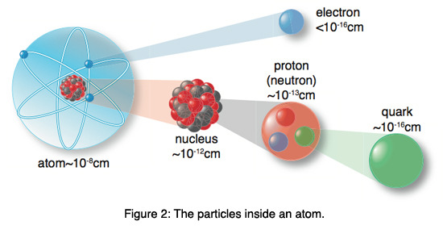

Slide 21
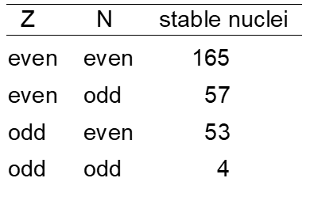

Nuclear Stability: Segre Plot
An attractive nuclear force must balance repulsive electric force
Neutrons and protons affected by the strong nuclear force
279 elements have stable nuclei
Elements with Z > 83 are unstable
1200 elements are unstable (radioactive)
(65 natural, remaining are humanmade)

Slide 22
Stable Nuclei
Stable nuclei do not decay by the strong interaction. They may transform by and emission (weak or electromagnetic) with long lifetimes.
Characteristics
Light nuclei tend to have N=Z. Heavy nuclei have more neutrons, N > Z.
Most have even N and/or Z. Protons and neutrons tend to form pairs (only 8/284 have odd N and Z).
Certain values of Z and N exhibit larger numbers of isotopes and isotones.

Slide 23
Possible decay paths (Segre Chart)

Slide 24
Binding Energy
A nucleus is held together by strong nuclear force. This force only acts over distances of a few fermis. Total energy of nucleus is less than combined energy of individual nucleons.
The binding energy (BE) of a nucleus is the energy required to separate a nucleus into its constituent parts. The theoretical explanation for mass defect is based on the Einstein's equation
E = mc²
When Z-protons and N-neutrons combine to form a nucleus, some of the mass (Δm) disappears, because it is converted into an amount of energy ΔE = (Δm)c²,
where Δm = Zm_{p} + Nm_{n} − M(A,Z) and c²= 931.5 MeV/u
This energy is called as Binding Energy (BE)
ΔE = (Δm)c² = [(Zm_{p} + Nm_{n}) − M(A,Z)] c²

Slide 25
Mass Defect
The mass defect (m_{D}) is the difference between the rest mass of a nucleus and the sum of the rest masses of its constituent nucleons. Example: Consider the carbon-12 atom (12.00000 u)
Nuclear mass = Mass of atom – Electron masses
= 12.00000 u – 6(0.00055 u) = 11.996706 u
The nucleus of the carbon-12 atom has this mass.
Mass of carbon-12 nucleus = 11.996706 u
Proton = 1.007276 u, Neutron = 1.008665 u
The nucleus contains 6 protons and 6 neutrons:
6 p = 6(1.007276 u) = 6.043656 u
6 n = 6(1.008665 u) = 6.051990 u
Total mass of parts: =12.095646 u
Mass defect m_{D} = 12.095646 u – 11.996706 u = 0.098940 u
Binding Energy (BE) of a nucleus is the energy required to separate a nucleus into its constituent parts.
BE = m_{D}c², where c² = 931.5 MeV/u.
Binding energy for carbon-12 = (0.098940 u)(931.5 MeV/u) = 92.2 MeV

Slide 26
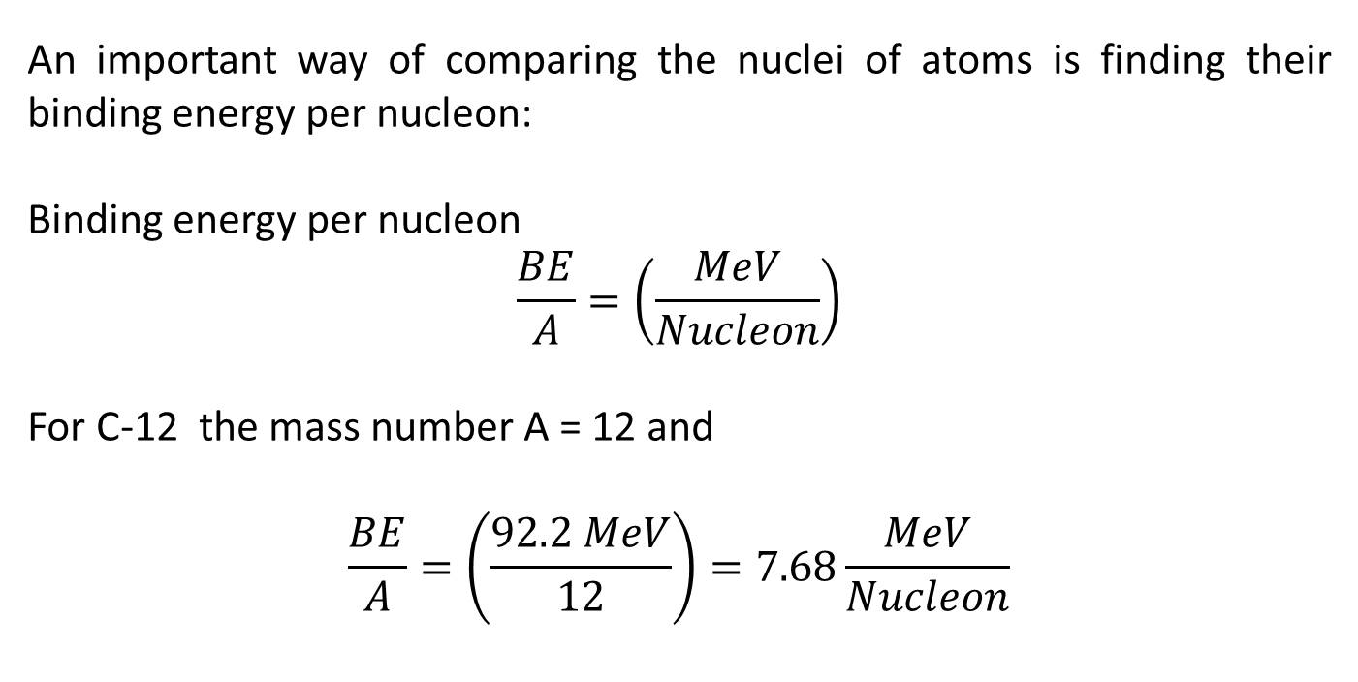
Binding Energy per Nucleon
An important way of comparing the nuclei of atoms is finding their binding energy per nucleon:
Binding energy per nucleon
$$\frac{BE}{A}=\left(\frac{MeV}{Nucleon}\right)$$
For C-12 the mass number A = 12 and
$$\frac{BE}{A}=\left(\frac{92.2 MeV}{12}\right)=7.68\frac{MeV}{Nucleon}$$

Slide 27
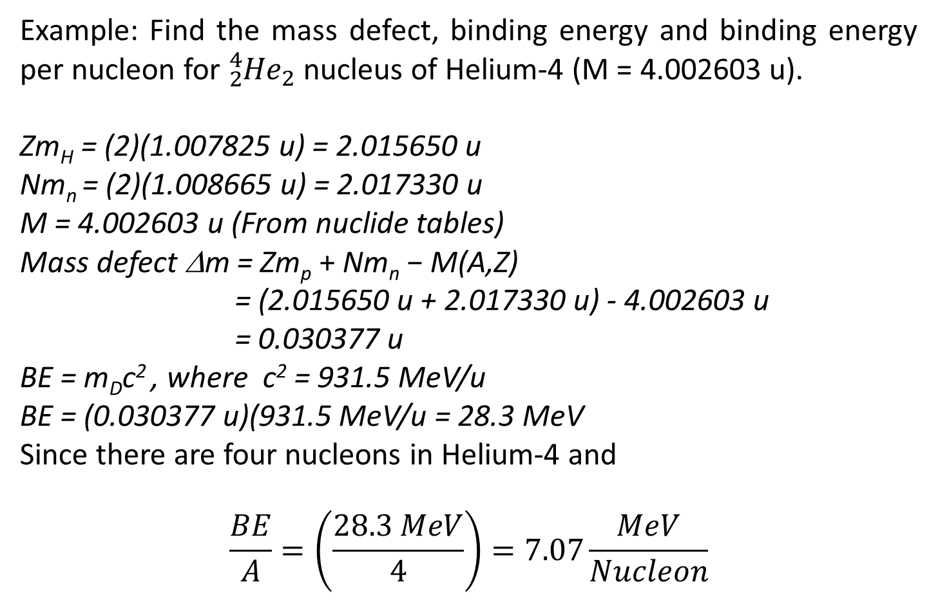
Binding Energy per Nucleon
Example: Find the mass defect, binding energy and binding energy per nucleon for ${}_{2}^{4}{{He}_{2} }$nucleus of Helium-4 (M = 4.002603 u).
Zm_{H} = (2)(1.007825 u) = 2.015650 u
Nm_{n} = (2)(1.008665 u) = 2.017330 u
M = 4.002603 u (From nuclide tables)
Mass defect Δm = Zm_{p} + Nm_{n} − M(A,Z)
= (2.015650 u + 2.017330 u) - 4.002603 u
= 0.030377 u
BE = m_{D}c² , where c² = 931.5 MeV/u
BE = (0.030377 u)(931.5 MeV/u = 28.3 MeV
Since there are four nucleons in Helium-4 and
$$\frac{BE}{A}=\left(\frac{28.3 MeV}{4}\right)=7.07\frac{MeV}{Nucleon}$$

Slide 28
Binding Energy per Nucleon
Example: ⁵⁴Fe has mass of 53.9396 u. A proton (with electron) has a mass of 1.00782 u and a neutron has a mass of 1.00866 u. Find the binding energy and binding energy per nucleon of iron-54 in MeV
SOLUTION: ⁵⁴Fe: A = 54, Z = 26, N = 54 - 26 = 28.
The constituents of ⁵⁴Fe are thus: 26(1.00782 u) + 28(1.00866 u) = 54.4458 u
The mass defect is thus ∆m = 54.4458 u – 53.9396 u = 0.5062 u
The binding energy is thus BE = (0.5062)(931.5 MeV) = 471.5 MeV.
The binding energy per nucleon is
BE / A = 471.5 MeV / 54 nucleons
= 8.7 MeV / nucleon

Slide 29
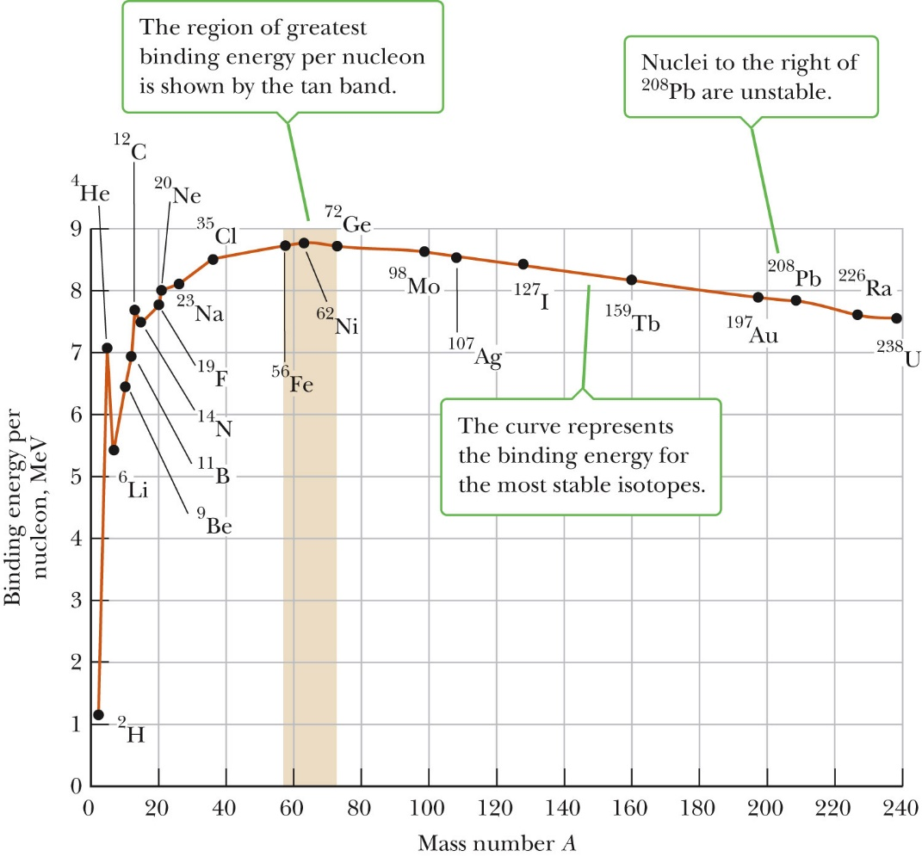
For lighter nuclei, energy is released when they fuse together (fusion).
For heavier nuclei, energy is released when they break up (fission).

Slide 30
Conclusions of Binding Energy per Nucleon v/s Mass Number
The average value of BE/A is around 8 MeV
The largest value occurs at around Fe-56. This implies that Fe-56 is the most stable nucleus.
Nuclear fusion will occur with the elements below Fe because joining smaller nuclei forms bigger ones, which are higher on the graph (and thus more stable).
Nuclear fission will occur with the elements above Fe because splitting bigger nuclei forms smaller ones, which are higher on the graph (and thus more stable).
Notice that uranium 235 a more massive nucleus has a lower binding energy per nucleon.
If you can “split” a nucleus of U-235 you will release the excess binding energy, because lower mass “fission products” with higher binding energy per nucleon will be produced.

Slide 31
Conclusions of Binding Energy per Nucleon V/S Mass Number
Less the B.E/nucleon, less is stability of nucleus where as if B.E/nucleon is higher more is stability - Thus Helium is more stable than deuteron.
Up to A=20 B.E/A increases, the curve has got variation upto A=16.
The nuclei He, C, O indicate B.E/A is higher than adjoining nuclei - They show extra stability - because these nuclei are considered to possess magic number, equal pairs of neutrons and protons inside the nucleus (2, 8, 14, 20, 28, 50, 82, 126), the binding energy curve becomes discontinuous. These numbers 2, 8, 14, 20, 28, 50, 82, and 126 are called the magic numbers.
The B.E first increases sharply and attains maximum value for A=56 of 8.8 MeV.

Slide 32
Conclusions of Binding Energy per Nucleon V/S Mass Number
B.E/A is positive for all values of mass number - it means that all nuclei are stable i.e., nuclear forces are attractive.
For A>20 the B.E is nearly constant, it can be concluded from here that inside nucleus nucleons exert attractive forces on neighboring nucleons only in limited number i.e., nuclear forces are saturated.
The B.E for A=56 is maximum and then gradually decrease with increase in A and ultimately for heavy nuclei of A>200 its value becomes nearly 7.6MeV that is heavy nuclei are relatively less stable.
So, they split into two lighter nuclei (nuclear fission) the B/A increases and in the process tremendous energy is released.
Similarly two lighter nuclei combine to form a relatively heavy nucleus (nuclear fusion) the B/A increases and in the process huge energy is released.

Slide 33
Separation Energy
Separation energy is the amount of energy required to remove a nucleon from the nucleus.
Neutron Separation Energy S_{n}
The neutron separation energy is the amount of energy needed to remove a neutron from a nucleus - Shows the stability of nuclei built from α-particles - Mass increasing in jumps of 4.
S_{n}(Z,N) = m(Z,N-1) + m_{n} - m(Z,N) = -Q_{n} for n-decay
Neutron drip line is at S_{n} = 0, beyond the drip line S_{n}< 0 the nuclei are neutron unbound
Proton Separation Energy S_{p}
The proton separation energy is the amount of energy needed to remove a proton from a nucleus
S_{p}(Z,N) = m(Z-1,N) + m_{p} - m(Z,N)
Proton drip line is at Sp = 0

Slide 34
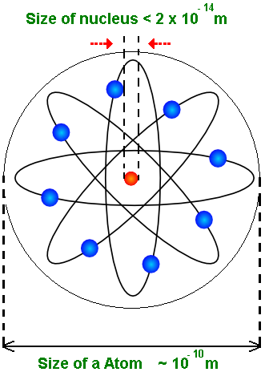
Nuclear Size
Scattering experiments determine size
Measured in femtometers
All nuclei have nearly the same density
For an atomic nucleus
This implies the density of an atomic nucleus is independent of A.
Example: Find the radius and volume of the nucleus
The radius is
The volume is
where r₀ = 1.2×10⁻¹⁵ m = 1.2 fm

Slide 35
Nuclear Size
The size of a nucleus may be determined using two sorts of interaction:
1) Electromagnetic Interaction gives the charge distribution of protons
inside the nucleus, e.g.
electron scattering
muonic atoms
mirror nuclei
2) Strong Interaction (Nuclear Force Method) gives matter distribution of protons and neutrons inside the nucleus. Sample nuclear and charge interactions at the same time – more complex, e.g.
particle scattering (Rutherford)
proton and neutron scattering
Lifetime of particle emitters
π-mesic X-rays.

Slide 36
Nuclear Size: Electron Scattering

Slide 37
Electron Scattering Method
In this method elastic scattering of high energy electrons is studied and from the knowledge of the scattered electrons, the radius constant R₀ is computed (from R=R_{o}A^{1/3}). The reduced de Broglie wavelength of a 200 MeV electron is about 10⁻¹³ cm. And therefore such particles which interact strongly with electric charges are very useful for probing the nucleus. The experiment was performed by Hofstadter and others at Sandford University.
The electron beam from a linear accelerator after momentum analysis is allowed in the scattering chamber with the help of two deflecting magnets. In the center of the scattering chamber, the beam passes through a thin gold foil (or any other scattering material) and the electrons scattered by the electric fields of the nuclei then fall on a magnetic spectrometer when they again undergo momentum analysis to record only the elastic events. The spectrometer can be rotated about an axis through the target so that the intensity of scattered electrons can be observed as a function of angle θ .

Slide 38
Nuclear Size: Electron Scattering

Slide 39
Nuclear Size: Electron Scattering

Slide 40
Nuclear Size: Electron Scattering

Slide 41
Nuclear Size: Electron Scattering
The shape of the Fermi distribution

Slide 42
Nuclear Size: Electron Scattering

Slide 43
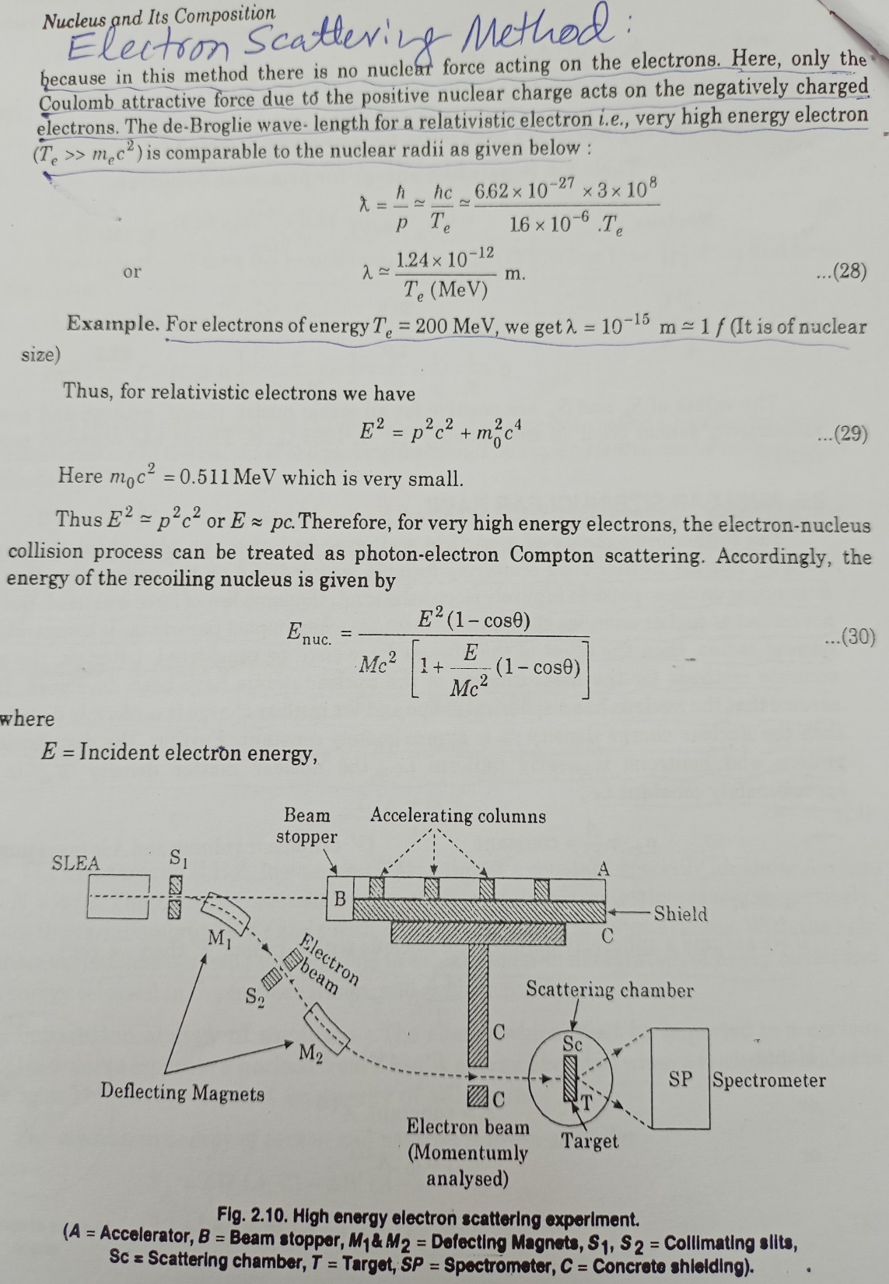

Slide 44
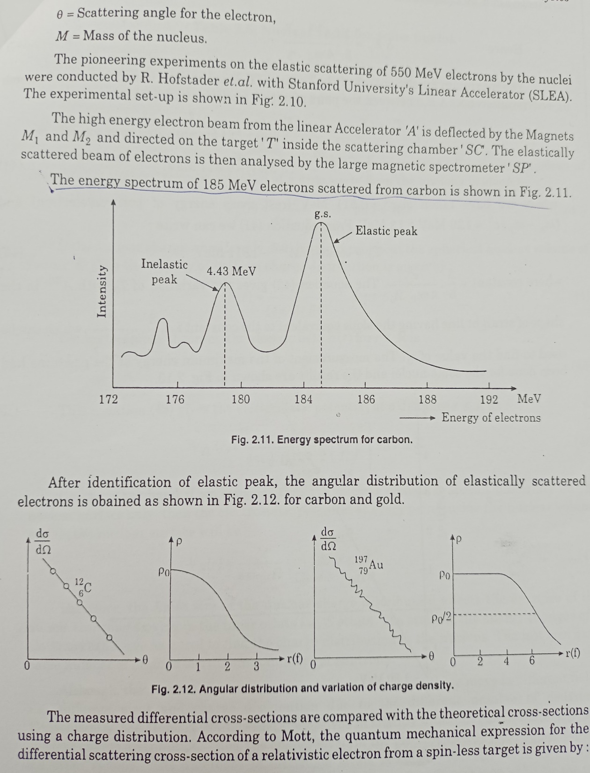

Slide 45
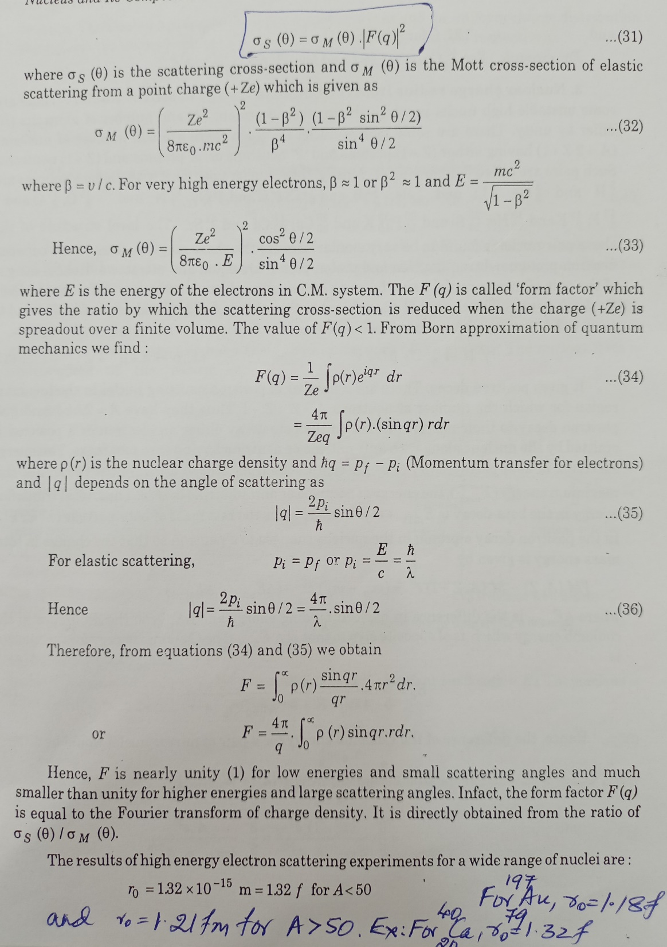

Slide 49
In the electron-nucleus collision, electron loses kinetic energy and nucleus recoils. The energy of the recoil nucleus E_{n} can be calculated by treating the electron-nucleus to be similar to a photon-electron Compton collision.
If E_{n} = Energy of recoil nucleus. E = energy of incident electron,
M = Mass of the nucleus, θ = Scattering angle.
Then from the theory of Compton effect
The energy of scattered electron E is thus given by E’ = E – E_{n}.
Hofstadter and others assumed that the density of charge in the nucleus is best given by

Slide 50
where p₀ and k are constants and c is that value of r where p_{(r)} falls to half its central value (i.e. p_{(r)} = p₀/2).
The experimental results with gold were analyzed in terms of the above equation and the results for a wide range of nuclei indicated c to be proportional to A^{1/3} and it was found that the results fit well within the formula
R = R_{o}A^{1/3}.
With value of R_{o} as R_{o} = 1.32 fermi for A < 50
And R_{o} = 1.32 ± 0.01 fermi for A > 50.

Slide 51
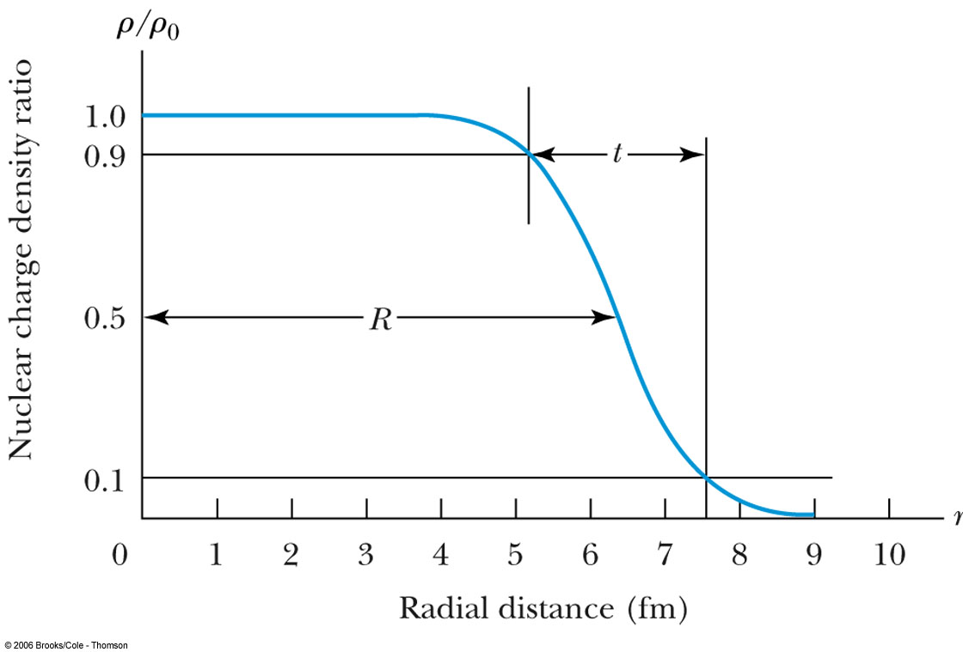
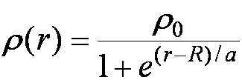
The nuclei have Fermi-type charge distribution described by two parameters, the radius c which depends on the number of nucleons and a surface thickness t which is constant for all nuclei
Nucleons have a finite size and can be described by an exponential charge/magnetic moment distribution.
The development of the electron scattering method which is used today to measure the form factors of nuclei/nucleons
The shape of the Fermi distribution

